Slide 1
Lecture 33
Dec. 4th , 2019
Return lab 6-7
  Discuss
Discuss Drosophila analysis—flies will be placed in the freezer today, unless you instruct me otherwise with your vial(s)
Exam 3 returned Friday if possible
GFP paper returned Monday
Lab 10—linked to the website.

Slide 2
Where were we?
DNA structure
DNA replication

Slide 3
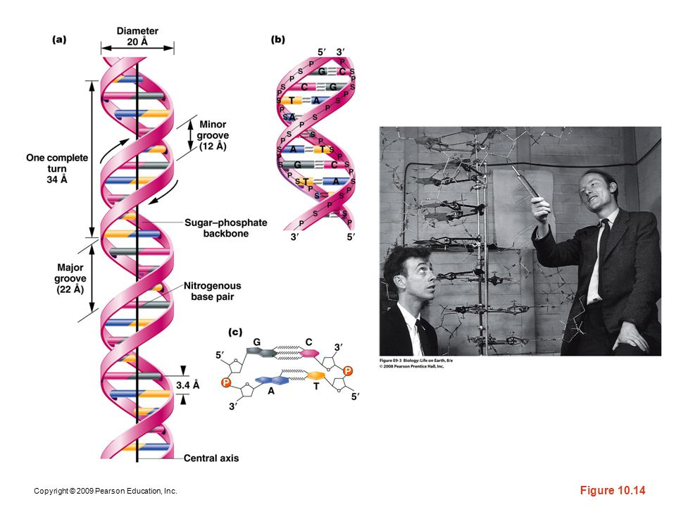
The Watson-Crick Model---Also known as B-DNA
Figure 10.14
Notes:
Figure 10-14 (a) The DNA double helix as proposed by Watson and Crick. The ribbonlike strands constitute the sugar-phosphate backbones, and the horizontal rungs constitute the nitrogenous base pairs, of which there are 10 per complete turn. The major and minor grooves are apparent. The solid vertical bar represents the central axis. (b) A detailed view depicting the bases, sugars, phosphates, and hydrogen bonds of the helix. (c) A demonstration of the antiparallel nature of the helix and the horizontal stacking of the bases.

Slide 4
Read Watson and Crick’s complete paper published in 1953 in Nature journal.
P.248 of your text.
Read it!

Slide 5
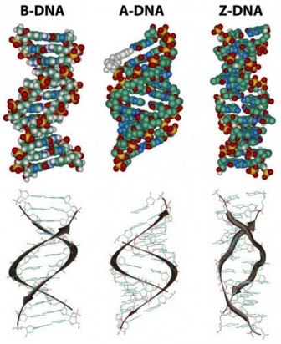
Figure 10-15

Slide 6
After the double helix…
…”It has not escaped our notice that the specific pairing we have postulated immediately suggests a possible copying mechanism for the genetic material”…
    Watson and Crick
    What did they mean? How did they see a mechanism for replication?

Slide 7
Semiconservative replication
  Replication of DNA occurs such that each new molecule is made of one “old” strand from the original parent molecule, and one newly synthesized strand.
    Each new molecule is partly concerved.

Slide 8
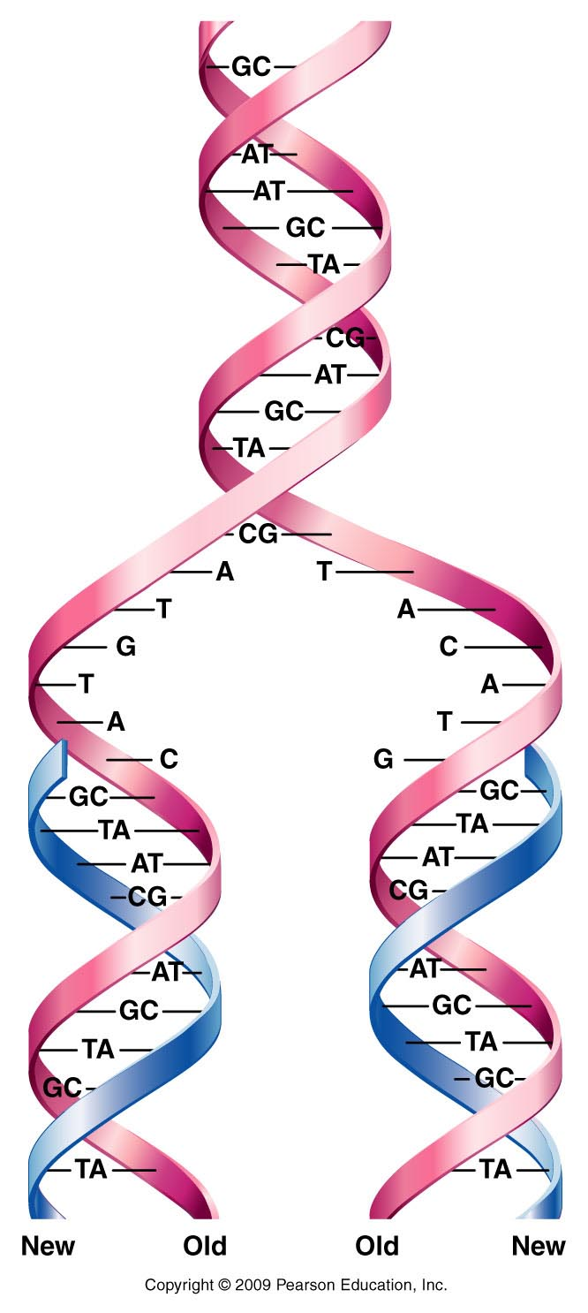
Figure 11.1
Notes:
Figure 11-1 Generalized model of semiconservative replication of DNA. New synthesis is shown in blue.

Slide 9
Experimental evidence—
Messelson and Stahl’s experiment
Like Hershey and Chase, used radiolabeling to distinguish how DNA was synthesized/copied.
What organism was used? E. coli
Hooray for E. coli!!!

Slide 10
The experiment
E.coli were grown in 2 types of LB broth.
  One had Nitrogen-14
  One had Nitrogen-15
  Nitrogen will be incorporated into nucleotide bases. DNA with N-15 is heavier, than DNA with N-14 and will sink faster in a centrifuging experiment.

Slide 11
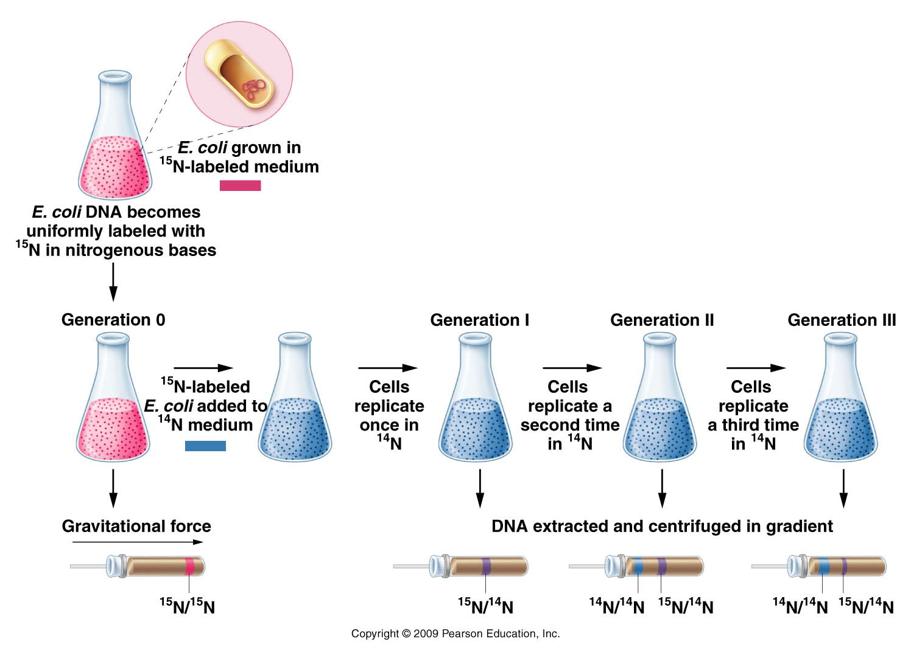
Figure 11.3
Notes:
Figure 11-3 The Meselson–Stahl experiment.

Slide 12
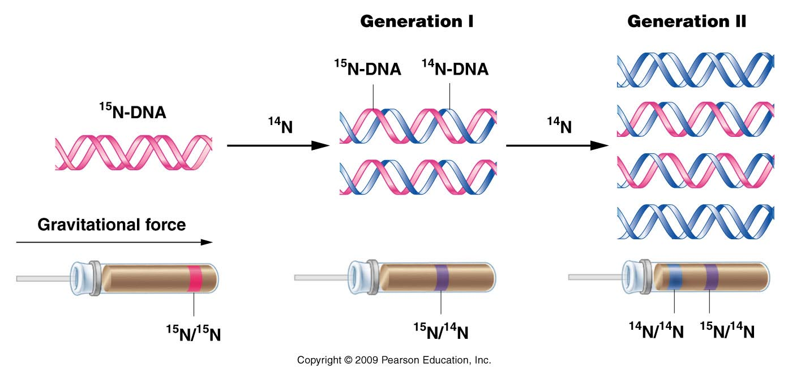
Figure 11.4
Notes:
Figure 11-4 The expected results of two generations of semiconservative replication in the Meselson–Stahl experiment.

Slide 13
The fact that the DNA was of intermediate weight after 1 round of replication supported the semi-conservative mechanism.
Why did the original DNA band disappear? Why did a lighter band begin to accumulate?
What might you expect after 2 rounds? 3 rounds? 100 rounds? Sketch the outcome using the same type of figure.
What would the result have looked like if DNA was replicated in a completely conservative manner?

Slide 14
Others added support for M-S experiment.
  Taylor, Woods, Hughes
    Also used radiolabeling of DNA, but looked at chromosomes microscopically. After radioisotope is removed and several rounds of replication, can observe that one chromatid of some of the chromosomes remains labeled, while other chromatid is not.

Slide 15
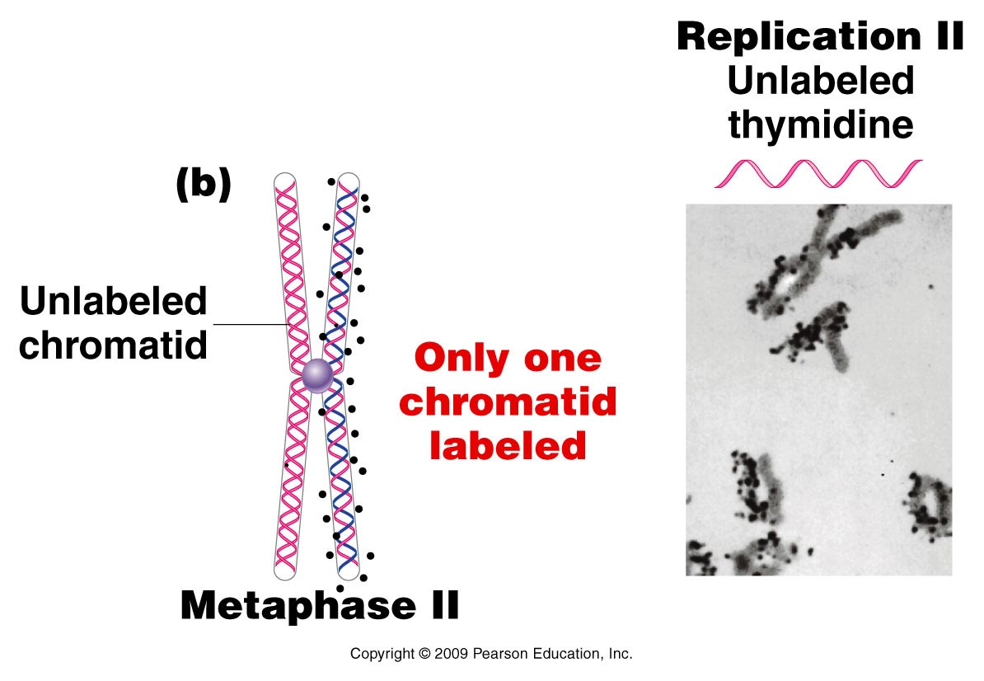
Figure 11.5b
Notes:
Figure 11-5b The Taylor–Woods–Hughes experiment, demonstrating the semiconservative mode of replication of DNA in root tips of Vicia faba. A portion of the plant is shown in the top photograph. (a) An unlabeled chromosome proceeds through the cell cycle in the presence of 3H-thymidine. As it enters mitosis, both sister chromatids of the chromosome are labeled, as shown, by autoradiography. After a second round of replication (b), this time in the absence of 3H-thymidine, only one chromatid of each chromosome is expected to be surrounded by grains. Except where a reciprocal exchange has occurred between sister chromatids (c), the expectation was upheld. The micrographs are of the actual autoradiograms obtained in the experiment.

Slide 16
A closer look at DNA replication…
What occurs at the molecular level?
In 1957 Arthur Kornberg provided first evidence of a DNA replicating enzyme. Isolated it from E. coli
  Called it DNA polymerase because it seemed to be able to link nucleotides to create a nucleotide polymer.

Slide 17
Kornberg needed to add provide this enzyme with:
Existing DNA molecule to copy (now called the template)
DNA building blocks---nucleotides
-tri-phosphate forms (dTTP, dATP, dCTP, dGTP) together, referred to as dNTPs.
N=any of the 4 deoxyribonucleotides.

Slide 18
Enzyme called DNA polymerase I---first one to be isolated. Now know that E. coli makes
I
II
III
IV
V

Slide 19
Kornberg’s discovery…
Enzyme called DNA polymerase I---first one to be isolated. Now know that E. coli makes
I
II
III---actually the enzyme that does most of the DNA synthesis in E. coli
IV
V

Slide 20
DNA replication…
Kornberg’s DNA polymerase I (and all DNA polymerases) link nucleotides in a 5’ 3’ direction.
Nucleoside triphosphates (dNTPs) are hydrolzyed to nucleoside monophosphates (dMTPs) with the release of inorganic phosphate.

Slide 21
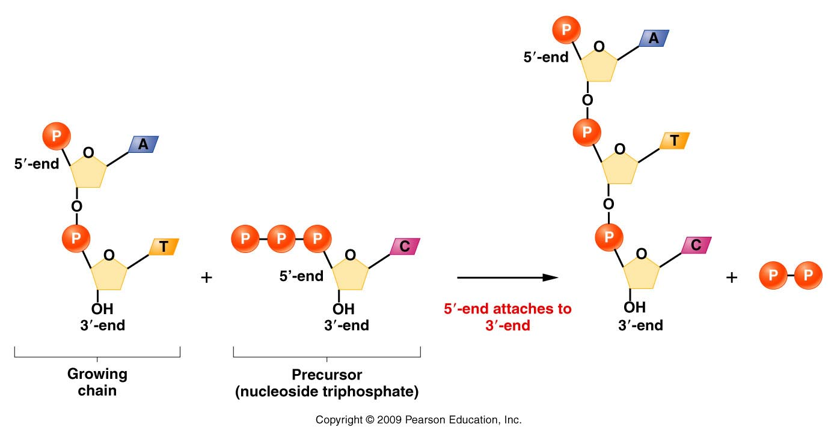
Figure 11.8
Notes:
Figure 11-8 Demonstration of 5’ to 3’ synthesis of DNA.

Slide 22
Now realize that DNA polymerases can only extend existing stretch of DNA. Cannot start a new strand from scratch.
  DNA polymerases require a nucleic acid “primer”.
    In cells this primer is a short stretch of RNA (made by an RNA polymerase). In in vitro replication the primer can be RNA or DNA.

Slide 23
DNA polymerases require a free 3’0H group.
Figure 11.8
Notes:
23
Figure 11-8 Demonstration of 5’ to 3’ synthesis of DNA.

Slide 24
Where does a DNA molecule begin its replication?...
Specific regions of chromosome are recognized by proteins that help open the helix and expose each strand.
  Region of the DNA is called:
    Origin of replication [Ori] (in prokaryotes)
    Autonomously replicating sequences (ARS) [in eukaryotes]

Slide 25
The Ori/ARS region is typically rich in A-T base pairs.
Why more A-T base pairs than G-C base pairs in these regions?

Slide 26
Recall the question regarding pGLO plasmid in lab? Does the plasmid replicate in the transformed bacteria? Yes!
And the only way any DNA molecule can be replicated is if it has within its sequence a signal for replication. (part of an E.coli origin of replication is shown here.)
GAT CTATTTATTT AGAGATCTGT TCTATTGTGA TCTCTTATTA

Slide 27
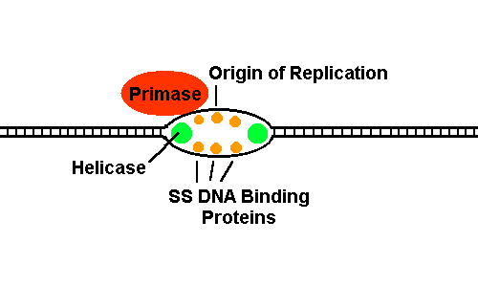
Note that this sequence is A-T rich!
A-T base pairs have 2 hydrogen bonds whereas G-C base pairs have 3 hydrogen bonds.
  Less energy required to break A-T bp.
Once open, the origin resembles a small bubble in the DNA

Slide 28
DNA polymerase must have many helper proteins…

Slide 29
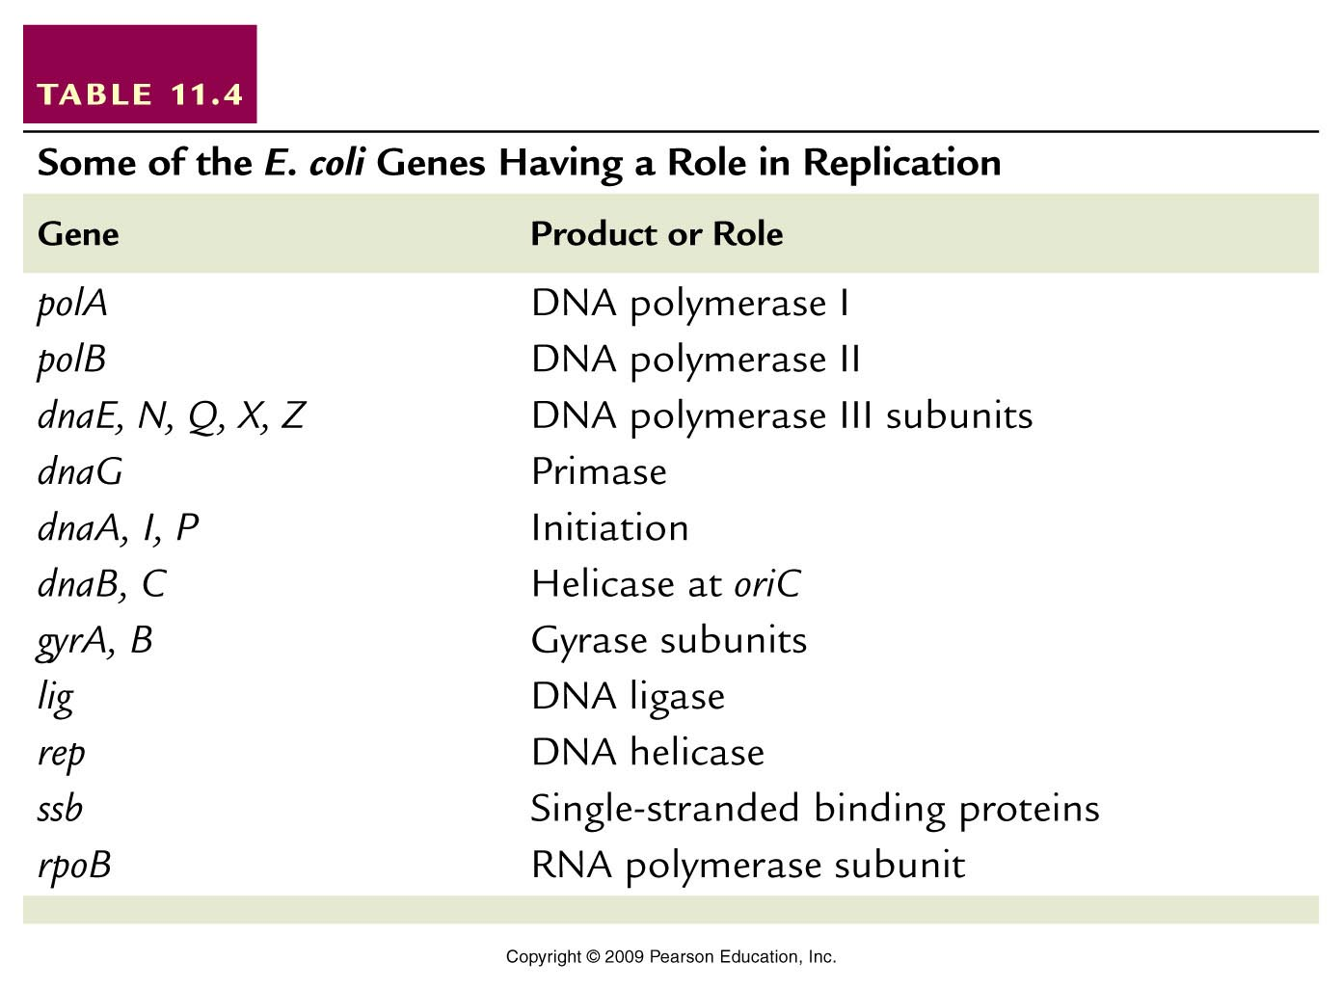
Helper proteins
Table 11.4
Notes:
Table 11-4 Some of the E. coli Genes Having a Role in Replication

Slide 30
The DNA templates will be antiparallel DNA strands…
If DNA synthesis begins at one position, and if both strands are to be copied, we must consider some potential problems…
Either DNA synthesis must proceed in 5’--3’ direction on one strand and 3’--5’ direction on the other strand
OR
DNA synthesis must proceed in opposite directions from a starting point.

Slide 31
All DNA polymerases sythesize DNA 5’-3’
**Therefore DNA synthesis likely proceeds in opposite directions on the 2 template strands.

Slide 32
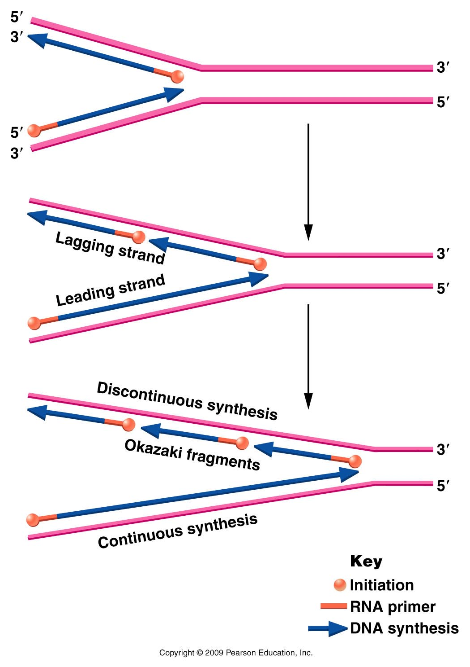
Figure 11.11
Notes:
Figure 11-11 Opposite polarity of DNA synthesis along the two strands, necessary because the two strands of DNA run antiparallel to one another and DNA polymerase III synthesizes only in one direction ( to ). On the lagging strand, synthesis must be discontinuous, resulting in the production of Okazaki fragments. On the leading strand, synthesis is continuous. RNA primers are used to initiate synthesis on both strands.

Slide 33
However, the best way to conserve energy and to stay organized in replication is to proceed from one start point and move in one overall direction.
(But replication must proceed in opposite directions!!)

Slide 34
Solution…
Continuous and discontinuous replication…
One strand (leading strand template) allows for continuous DNA synthesis in one direction.
Other strand (lagging strand template) requires DNA synthesis in the opposite direction, but it can occur in short, discontinuous stretches.

Slide 35
Figure 11.11
Notes:
Figure 11-11 Opposite polarity of DNA synthesis along the two strands, necessary because the two strands of DNA run antiparallel to one another and DNA polymerase III synthesizes only in one direction ( to ). On the lagging strand, synthesis must be discontinuous, resulting in the production of Okazaki fragments. On the leading strand, synthesis is continuous. RNA primers are used to initiate synthesis on both strands.

Slide 36
Short fragments of DNA made from the lagging strand, called Okasaki fragments.
Eventually primers are removed and Okasaki fragments are linked into a continuous strand of DNA. (Role of Rnase, DNA pol I , and DNA ligase in prokaryotes like E. coli) (Details coming!)
This extra work takes time so the synthesis lags behind the continuous synthesis.

Slide 37
View this animation
(also found on website)
http://www.wiley.com/college/pratt/0471393878/student/animations/dna_replication/index.html
It is an excellent review!!!!!

Slide 38
Let’s look closer at one replication fork. Recall both strands are being copied simultaneously and the polymerase enzymes are moving in one overall direction.
Current model for how this might work.

Slide 39
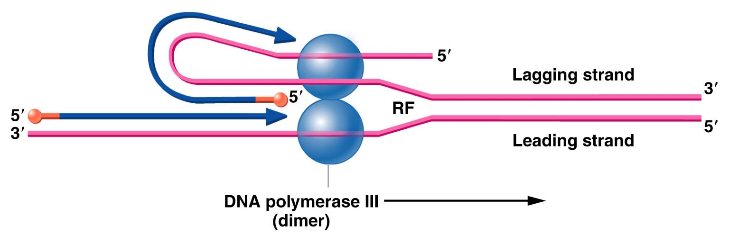
Figure 11.12
Notes:
Figure 11-12 Illustration of how concurrent DNA synthesis may be achieved on both the leading and lagging strands at a single replication fork. The lagging template strand is “looped” in order to invert the physical direction of synthesis, but not the biochemical direction. The enzyme functions as a dimer, with each core enzyme achieving synthesis on one or the other strand.

Slide 40
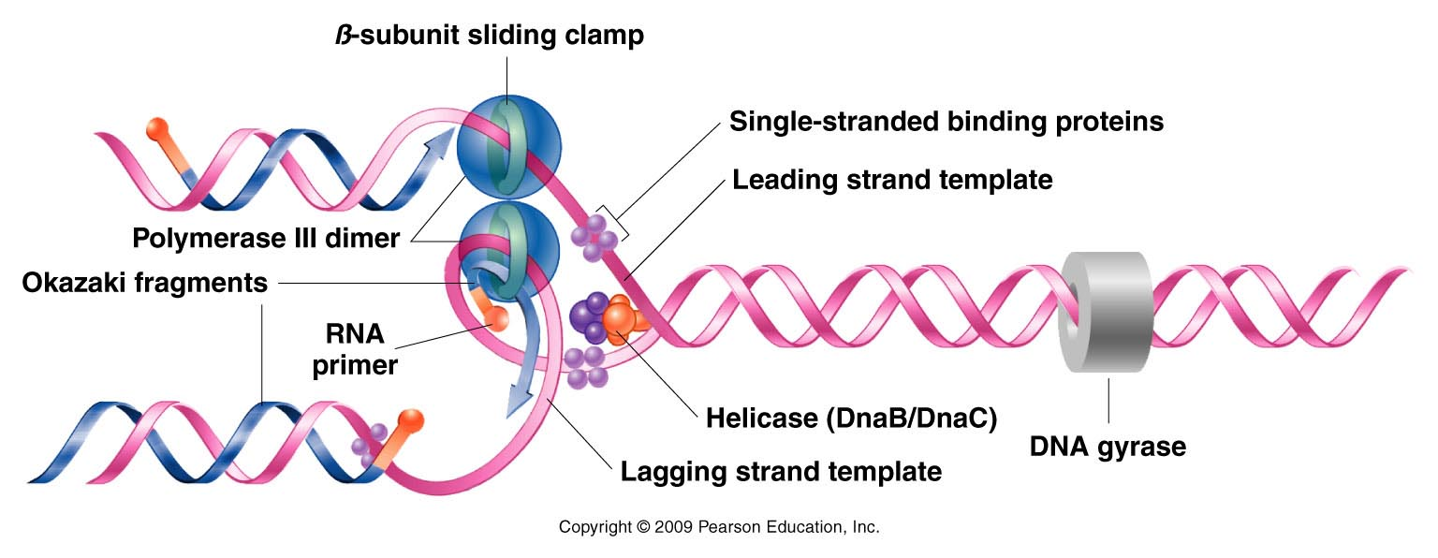
A more detailed look showing the relative positions of the helper proteins at a replication fork. Study and re-sketch!
Figure 11.13
Notes:
Figure 11-13 Summary of DNA synthesis at a single replication fork. Various enzymes and proteins essential to the process are shown.

Slide 41
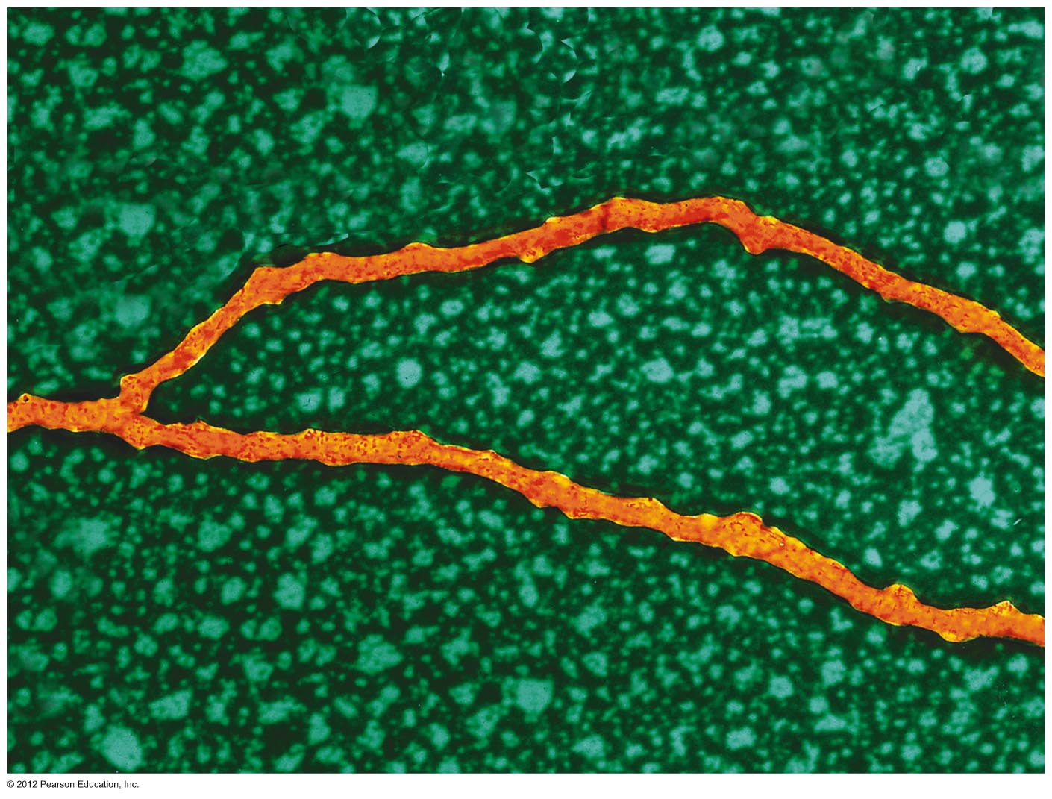
An actual replication fork
Notes:
Chapter 11 Opener

Slide 42
Bacteria like E. coli have a single origin of replication which creates one replication bubble which forms two replication forks.
This creates conditions in which leading and lagging strands are opposite in the 2 different replication forks. It saves time for replication!

Slide 43
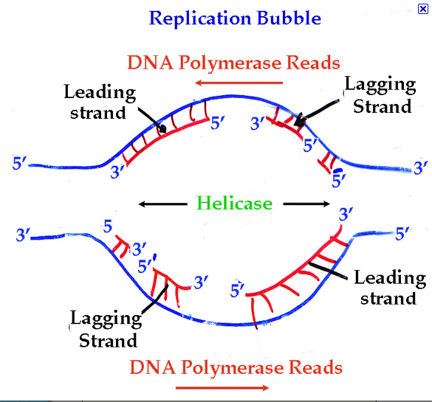
Study this!

Slide 44
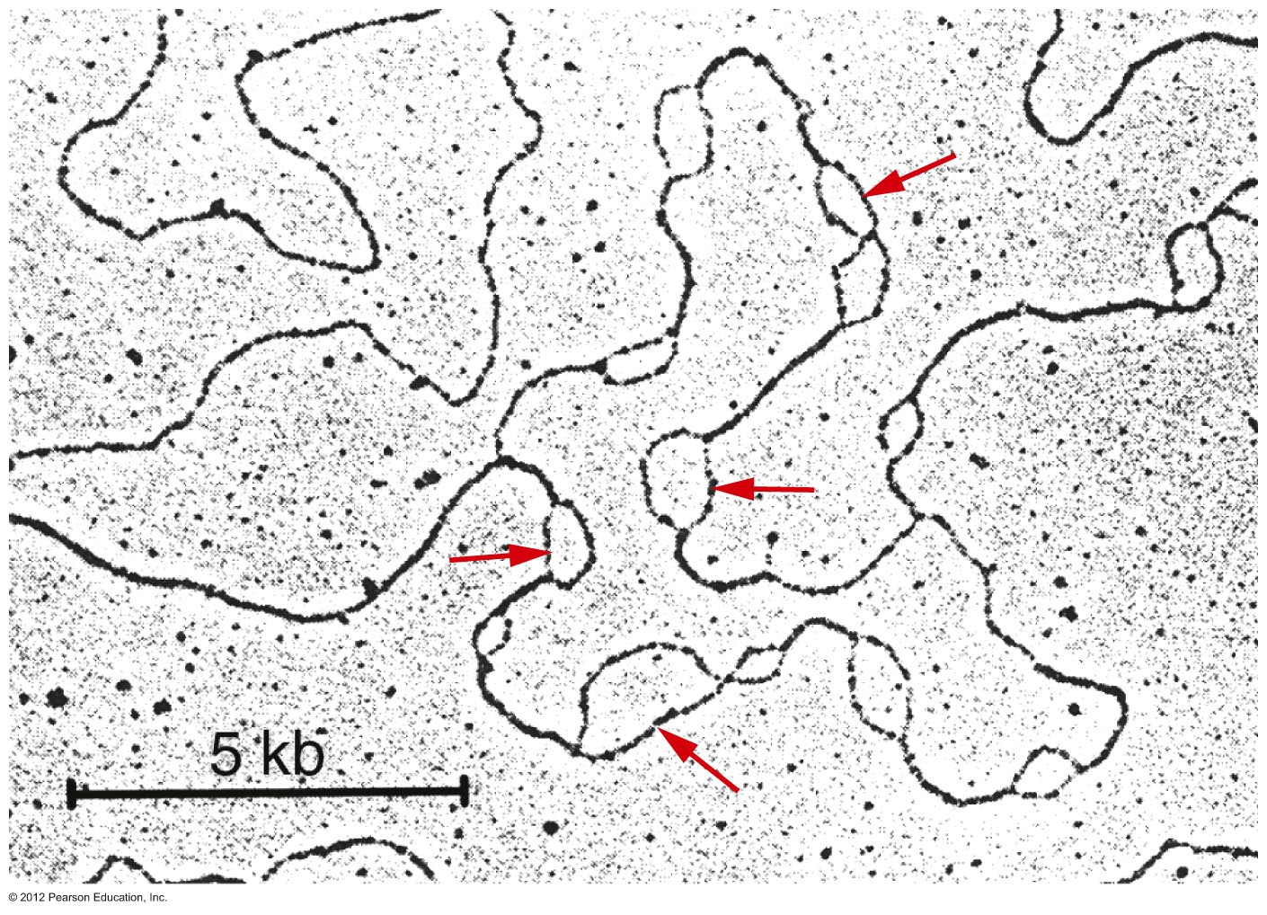
Eukaryotic cells have linear chromosomes which have multiple ARS sequences. Many replication bubbles form. Each bubble makes 2 replication forks.
Notes:
Figure 11.14

